Slide 1
Detailed Analysis of Ofinno patents related to: ePDCCH/PDSCH RRC Radio Resource Configuration vs. LTE-Advanced Standards and Other Prior Arts

Slide 2
Outline
This prior art analysis applies to the patents and patent applications related to ePDCCH/PDSCH configurations and signaling
6 example patents are considered in this analysis
Different patents claim a different aspect of ePDCCH/PDSCH configuration and signaling. Each patent has a different set of inventive aspects. In this analysis, we only focus on some of the limitations that appear (in one form or the other) in these patents/patent applications:
The claim limitations highlighted in red are considered in this analysis.
The claim limitations highlighted in blue also seem to disclose a novel aspect.
There may be other novel aspects in the claim. The objective was to highlight some example novel aspects.
The analysis does not include any opinion from the inventor.

Slide 3
Summary
A prior art analysis is performed to:
Understand how and when the red highlighted features were proposed to 3GPP LTE-Advanced standard. Result: November 12, 2012 by Alcatel-Lucent
Check if any 3GPP contribution prior to the priority date addressed these features. Result: None found
Check if these features have been discussed in any prior art patent application. Result: None found
IDSs were submitted to USPTO and the claims were independently allowed by 5 different Examiners in US and EU patent offices.

Slide 4
ePDCCH/PDSCH Patents and Patent Applications
Patent US8,576,794
Patent US8,526,393
Patent US8,804,772
Patent US8,699,449
Patent US8,811,333
Patent US8,908,633

Slide 5
The Disclosed ePDCCH/PDSCH Configuration
Legacy PDCCH
Legacy PHICH is used for ePDCCH HARQ
2nd Cont. Ch.
Set #1
2nd Cont. Ch.
Set #1
2nd Cont. Ch.
Set #1
2nd Cont. Ch.
Set #1
Data channel
Data channel
Data channel
Data channel
…
…
First Control Channel
First Control Channel
First Control Channel
First Control Channel
First Control Channel
First Control Channel
First Control Channel
First Control Channel
2nd Cont. Ch.
Set # 2
2nd Cont. Ch.
Set # 2
2nd Cont. Ch.
Set # 2
2nd Cont. Ch.
Set # 2
Data channel
Data channel
Data channel
Data channel
Subframe
#0
Subframe
#1
Subframe
#2
Subframe
#3
Subframe
#4
Subframe
#5
Subframe
#6
Subframe
#7
Starting OFDM Symbol of ePDCCH & PDSCH is configured by RRC in the subset of subframes. PDSCH has the same starting symbol as ePDCCH in the subset of subframes.
One or more sets of resource blocks in the subset of subframes are configured by RRC. Multiple sets of resources blocks are non-overlapping.
ePDCCH resources are configured in a subset of subframes. RRC indicates the configuration of the subset of subframes.

Slide 6
Example Claim of Patent US8,576,794
Claim 15: A wireless device comprising:
a) one or more communication interfaces; b) one or more processors; and c) memory storing instructions that, when executed, cause said wireless device to:
i) receive at least one message, from a base station, causing configuration of:
(1) first radio resources of a control channel, said first radio resources comprising one or more sets of resource blocks in a subset of subframes in a plurality of subframes, said at least one message indicating:
(a) a starting OFDM symbol of said control channel in said subset of subframes; and
(b) said subset of subframes in which said first radio resources of said control channel are configured; and
(2) second radio resources of a HARQ channel to start from the first OFDM symbol of said plurality of subframes, said at least one message indicating a number of symbols in said second radio resources in each subframe in said plurality of subframes;
ii) transmit a packet on an uplink channel according to scheduling information received on said first radio resources; and
iii) receive a positive or negative acknowledgement on said second radio resources.
Claim 19: The wireless device of claim 15, wherein said at least one message further causes configuration of third radio resources of a downlink channel to start from said starting OFDM symbol in said subset of subframes.

Slide 7
Example Claim of Patent US8,526,393
Claim 24. A method comprising:
a) receiving at least one radio resource control (RRC) message by a wireless device from a base station, said at least one RRC message configured to cause configuration of first radio resources of a control channel of a carrier, said first radio resources comprising one or more sets of resource blocks in a subset of subframes in a plurality of subframes, said at least one RRC message indicating configuration of said subset of subframes in which said first radio resources of said control channel are configured;
b) receiving scheduling information on said control channel in a first subframe of said subset of subframes, said scheduling information being for one or more data packets transmitted on a data channel of said carrier; and
c) receiving said one or more data packets by said wireless device from said base station on said data channel in said first subframe employing said scheduling information.
Claim 26. The method of claim 24, wherein said at least one RRC message further indicates a starting OFDM symbol of said first radio resources in said subset of subframes.
Claim 27. The method of claim 26, wherein second radio resources of said data channel of said carrier start from said starting OFDM symbol in said subset of subframes.

Slide 8
Example Claim of Patent US8,804,772
Claim 1: A method for use in a base station, the method comprising:
a) transmitting on a first control channel, to a wireless device, first scheduling information for a control message, first radio resources of said first control channel in a subframe in a plurality of subframes starting from the first OFDM symbol of said subframe;
b) transmitting, to said wireless device, said control message causing configuration of second radio resources of a second control channel, said second radio resources comprising one or more resource blocks in a subset of subframes in said plurality of subframes, said control message indicating:
i) said subset of subframes; and
ii) a starting OFDM symbol of said second control channel and a data channel in said subset of subframes; and
c) transmitting, to said wireless device, second scheduling information on said second control channel for a packet transmitted on said data channel.

Slide 9
Example Claim of Patent US8,699,449
Claim 1: A method for use in a base station, the method comprising:
a) transmitting, to a first wireless device, first scheduling information on a first control channel for a first packet communicated with said first wireless device, first radio resources of said first control channel starting from the first OFDM symbol of each subframe in a plurality of subframes;
b) transmitting, to a second wireless device, a radio resource control (RRC) message comprising configuration parameters of second radio resources of a second control channel, said second radio resources comprising one or more sets of resource blocks in a subset of subframes in said plurality of subframes, said RRC message indicating:
(i) a first starting OFDM symbol of both said second control channel and a data channel in said subset of subframes; and
(ii) said subset of subframes in which said second radio resources of said second control channel are configured; and
c) transmitting, to said second wireless device, second scheduling information on said second control channel for a second packet communicated with said second wireless device.

Slide 10
Example Claim of Patent US8,811,333
Claim 1: A method for use in a base station, the method comprising:
a) transmitting on a first control channel, to a wireless device, first scheduling information for a control message, first radio resources of said first control channel in a subframe in a plurality of subframes starting from the first OFDM symbol of said subframe;
b) transmitting, to said wireless device, said control message comprising configuration parameters of second radio resources of a second control channel, said second radio resources comprising multiple sets of resource blocks in a subset of subframes in said plurality of subframes, said control message indicating:
i) said subset of subframes; and
ii) a first starting OFDM symbol of both said second control channel and a data channel in said subset of subframes; and
c) transmitting, to said wireless device, second scheduling information on said second control channel for a packet transmitted on said data channel; and
wherein said configuration parameters comprise an array of parameters, each element in said array comprising frequency resource parameters for a set of resource blocks in said multiple sets of resource blocks.

Slide 11
Example Claim of Patent US8,908,633
Claim 1: A method for use in a base station, the method comprising:
a) transmitting on a first control channel, to a wireless device, first scheduling information for a radio resource control (RRC) message, first radio resources of said first control channel in a subframe in a plurality of subframes starting from the first OFDM symbol of said subframe;
b) transmitting, to said wireless device, said RRC message comprising configuration parameters of second radio resources of a second control channel, said second radio resources comprising one or more sets of resource blocks in a subset of subframes in said plurality of subframes, said RRC message indicating:
i) said subset of subframes in which said second radio resources are configured; and
ii) a first starting OFDM symbol of both said second control channel and a data channel in said subset of subframes, said first starting symbol being applicable to each subframe in said subset of subframes indicated in said RRC message; and
c) transmitting, to said wireless device, second scheduling information on said second control channel for a packet transmitted on said data channel.

Slide 12
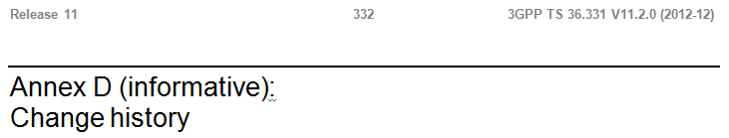
3GPP TS 36.331 – RRC Specification History
3GPP TS 36.331 v11.0 – June 2012
Did not include any spec on ePDCCH configuration
3GPP TS 36.331 v11.1 – September 2012
Did not include any spec on ePDCCH configuration
3GPP TS 36.331 v11.2 – December 2012
Included ePDCCH configuration parameters

Slide 13
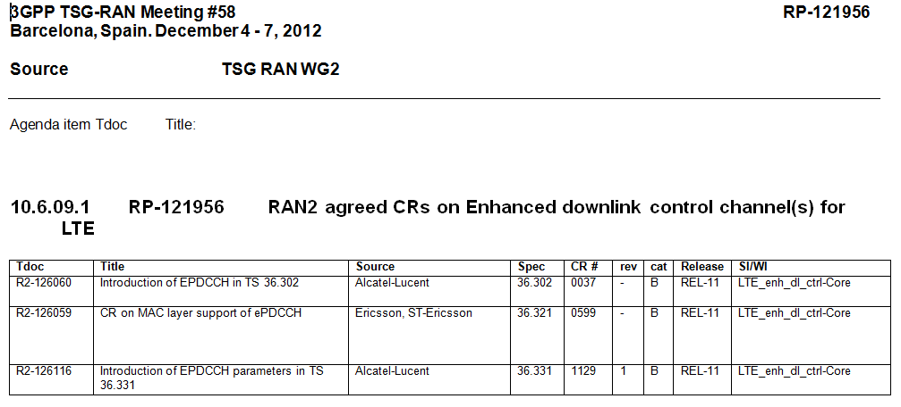
CRs on ePDCCH Agreed in Dec 2012 According to RP-121956.ZIP
The claim is related to ePDCCH parameters in TS 36.331. The other two CRs are not relevant to the claimed invention.
TS 36.302: Evolved Universal Terrestrial Radio Access (E-UTRA); Services provided by the physical layer

Slide 14
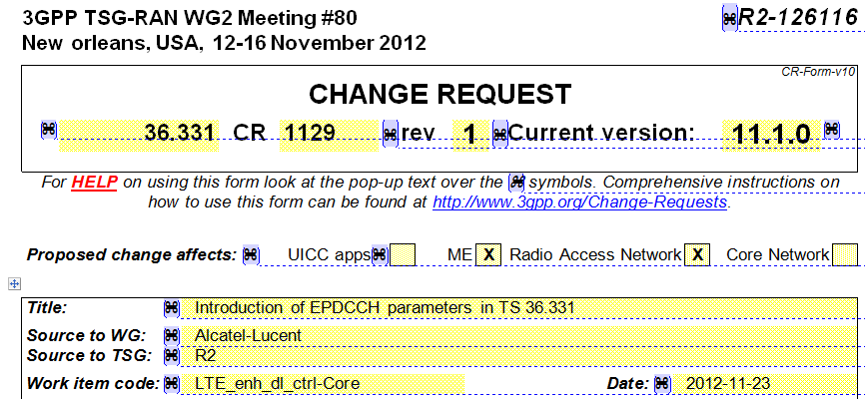
CR on ePDCCH RRC configuration was introduced by Alcatel-Lucent

Slide 15
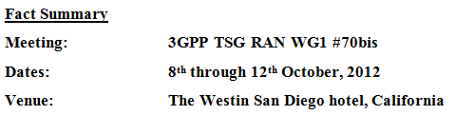
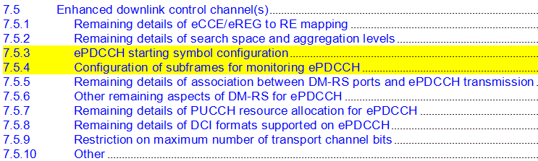
ePDCCH Configuration – Oct 2012
ePDCCH/PDSCH RRC configuration discussion started in October 2012
The two yellow highlighted sections were introduced in RAN1 agenda item in October 2012 to include related contributions

Slide 16
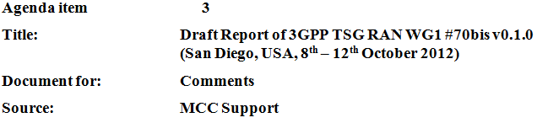
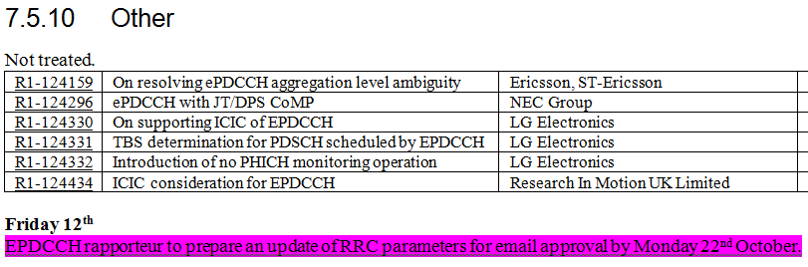
ePDCCH Configuration – Oct 2012

Slide 17

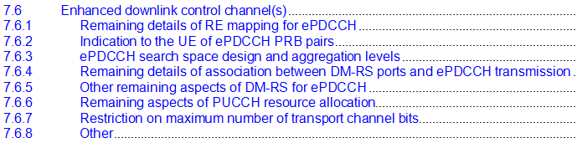
ePDCCH/PDSCH Configuration – Aug 2012
Agenda items prior to October 2012 were concerned about PHY layer issues and not ePDCCH RRC radio resource configuration parameters.

Slide 18
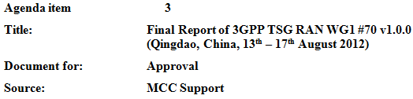
Further ePDCCH/PDSCH Configuration History
First contribution on some RRC parameters for ePDCCH was introduced in RAN WG1 meeting #70 in August 2012 by Alcatel-Lucent

Slide 19
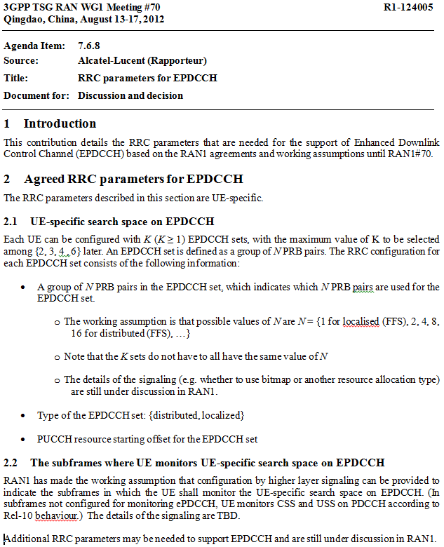
Alcatel-Lucent contribution is shown here.
This is the most relevant contribution in RAN WG1 meeting #70 in August 2012.
In August 2012, many other ePDCCH/PDSCH RRC configuration parameters, such as the starting symbol of ePDCCH and PDSCH in a subset of subframes was not under discussion yet.

Slide 20

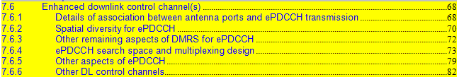
ePDCCH/PDSCH standardization in May 2012
Contributions submitted to RAN WG1 meeting #69 in May 2012 were reviewed. No contribution related to the claimed RRC radio resource configuration parameters were found. ePDCCH agenda for 3GPP RAN WG1 meeting #69 in May 2012 is shown below. None of the sections addresses the issues related to the claimed invention.
Contributions in meetings prior to May 2012 were also analyzed. The claimed RRC radio resource configuration parameters for ePDCCH/PDSCH were not discussed in 3GPP prior to August 2012.
Contributions in section 7.6.4 are not related to the claimed invention.
7.6.4.1 Handling of mapping of ePDCCH in presence of other signals
7.6.4.2 “(e)REG/(e)CCE” definitions
7.6.4.3 Aggregation levels and relationship to localised and/or distributed transmission
7.6.4.4 Need for multiplexing of localised and distributed ePDCCH parts in same PRBs
7.6.4.5 “Fallback” operation
Contributions in this section is shown in the next slides.

Slide 21
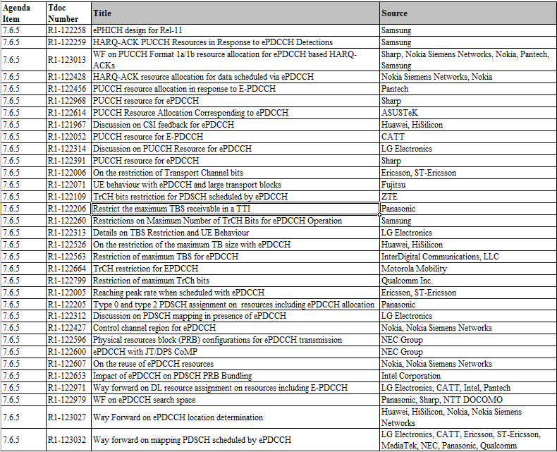
Contributions in section 7.6.5: Other Aspects of ePDCCH (May 2012, RAN WG1 Meeting 69)
These contributions are related to PUCCH and PHICH (and not related to the claimed invention).
These contributions are related TrCh TBS restrictions (and not related to the claimed invention).
None of these contributions are related to the claimed invention.

Slide 22
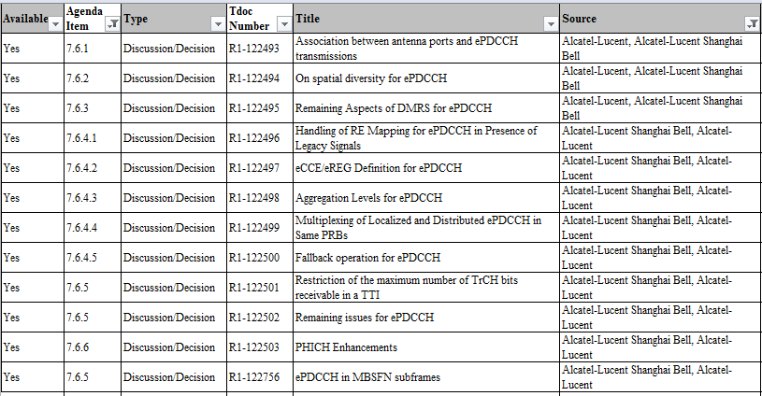
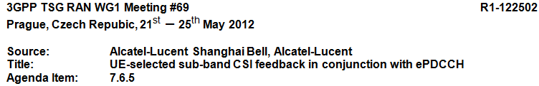
Alcatel-Lucent, which drafted the initial contributions and the CR on ePDCCH RRC radio resource configuration parameters, did not submit any contribution prior to August 2012 that is related to the claimed ePDCCH/PDSCH RRC radio resource configuration parameters.
For Example, Alcatel-Lucent contributions in May 2012 RAN WG1 Meeting #69 is shown below:
R1-122502 is not related to ePDCCH RRC configuration.

Slide 23
No Prior art was found by detailed search and analysis of 3GPP Contributions.
3GPP contributions prior to October 2012 do not address the claimed RRC ePDCCH/PDSCH radio resource configuration parameters.
3GPP contributions in August 2012 included some ePDCCH RRC radio resource configuration parameters, but did not include the claimed ePDCCH/PDSCH RRC radio resource configuration parameters.
Some of the discussions prior to August 2012 addressed whether RRC should be used for ePDCCH configuration, but none are related to the claimed invention.

Slide 24
Search in Patent Databases
Detailed search in patent and patent applications did not reveal any concerning prior art. Some example arts are listed below:
US2011/0249633, Hong et al., published 2011-10-13
US2011/0044391, Ji et al., published 2011-02-24
US2013/0286997, Davydov et al., published 2013-10-31
A more focused prior art search on Alcatel-Lucent patents did not reveal any prior art related to RRC ePDCCH/PDSCH radio resource configuration. Some example arts are listed below:
US 2013/0195068 A1, Baker et al, priority date: Jan 30, 2012
US 2013/0242750 A1, Baker et al, priority date: March 19, 2012
WO2013167967A2, Qi Jiang et al, priority date: May 9, 2012
WO 2013140241 A1, Liu et al, priority date: Mar 20, 2012

Slide 25
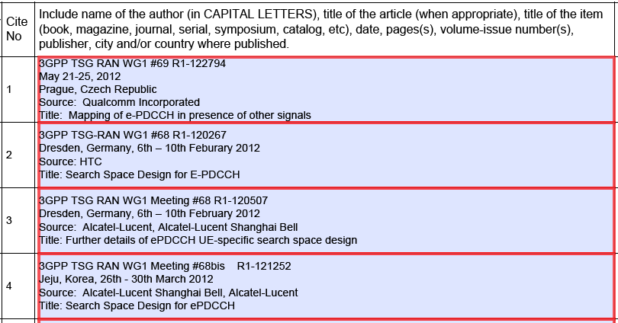
3GPP Contributions Submitted in IDS 1/2

Slide 26
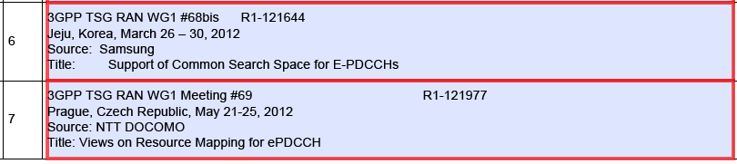
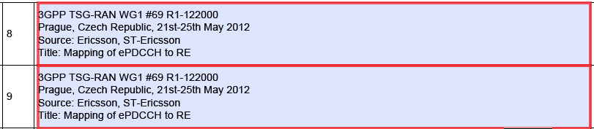
3GPP Contributions Submitted in IDS 2/2

Slide 27
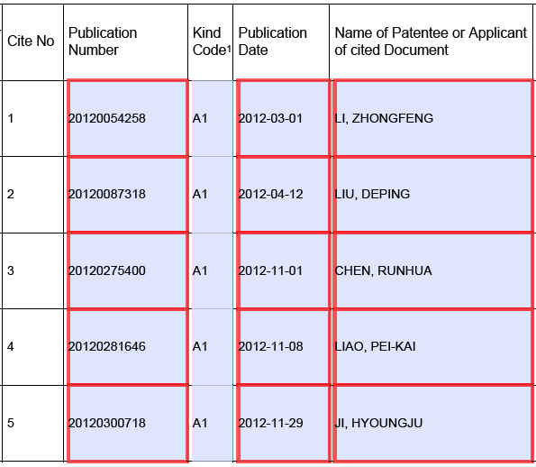
Prior Art Patents in IDS 1/6

Slide 28
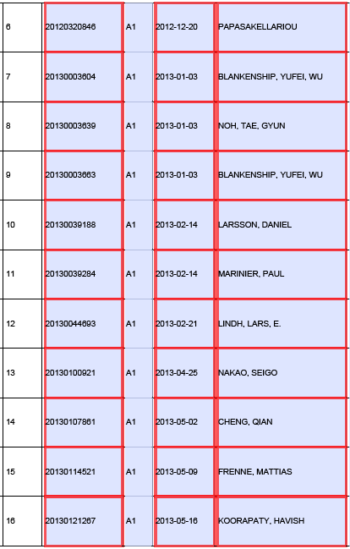
Prior Art Patents in IDS 2/6

Slide 29
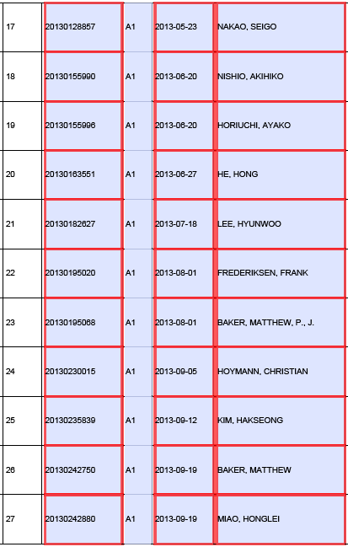
Prior Art Patents in IDS 3/6

Slide 30
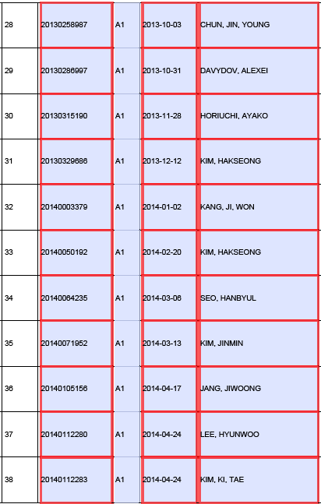
Prior Art Patents in IDS 4/6

Slide 31
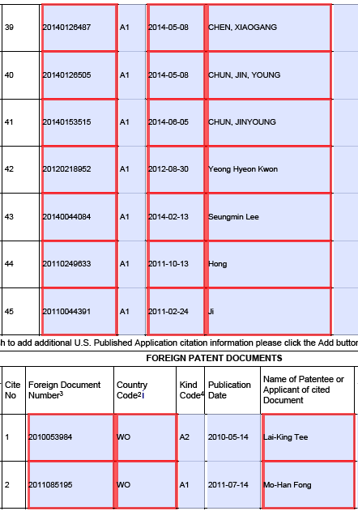
Prior Art Patents in IDS 5/6

Slide 32
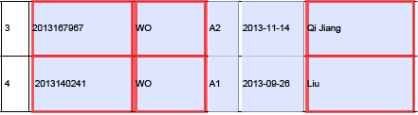
Prior Art Patents in IDS 6/6

Slide 33
Conclusion
No prior art was found by detailed search and analysis of 3GPP Contributions.
No patent prior art was found by detailed search in US and international patent databases.
The limitations were considered novel in multiple US and EU patent applications by 5 different US and EP patent office Examiners.

